Slide 1
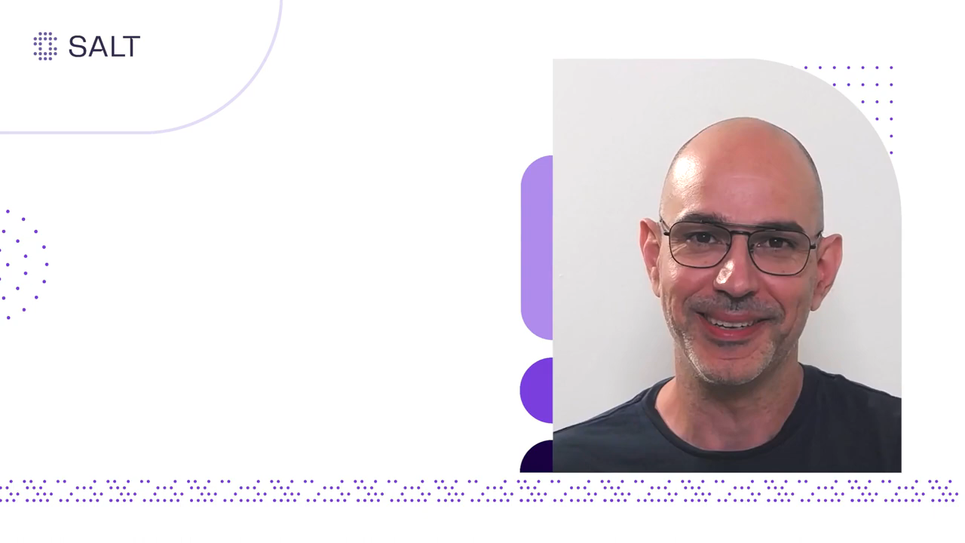

Slide 2
Ethical Hacking

Slide 3
Unit 1
Information Security: Attacks and Vulnerabilities Asset, Access Control, CIA, Authentication, Authorization, Risk, Threat, Vulnerability, Attack, Malware, Worms, viruses, Trojans, Spyware, Rootkits, Types of vulnerabilities: Top 10 OWASP.
Types of attacks and their common prevention mechanisms: Keystroke Logging, Denial of Service (DoS /DDoS), Waterhole attack, brute force, phishing and fake WAP, Eavesdropping, Man-in-the-middle, Session Hijacking, Clickjacking, Cookie Theft, URL Obfuscation, buffer overflow, DNS poisoning, ARP poisoning, Identity Theft, IoT Attacks, BOTs and BOTNETs
Case-studies: Recent attacks – Yahoo, Adult Friend Finder, eBay, Equifax, WannaCry, Target Stores, Uber, JP Morgan Chase, Bad Rabbit, Media Markt, Kaseya, JBS, Colonial Pipeline, The University of California at San Francisco.

Slide 4
What is Ethical Hacking
Also Called – Attack & Penetration Testing,
White-hat hacking, Red teaming
Hacking
Process of breaking into systems for:
Personal or Commercial Gains
Malicious Intent – Causing sever damage to Information & Assets
Ethical
Conforming to accepted professional standards of conduct
Black-hat – Bad guys
White-hat - Good Guys
Notes:
Red teaming – used for the first time by US government for testing its systems early 90’s
Black & white hat terminology comes from the Hollywood movies where good guys wear white hats and bad guys wear black hats

Slide 5
What is Ethical Hacking
It is Legal
Permission is obtained from the target
Part of an overall security program
Identify vulnerabilities visible from Internet at particular point of time
Ethical hackers possesses same skills, mindset and tools of a hacker but the attacks are done in a non-destructive manner

Slide 6
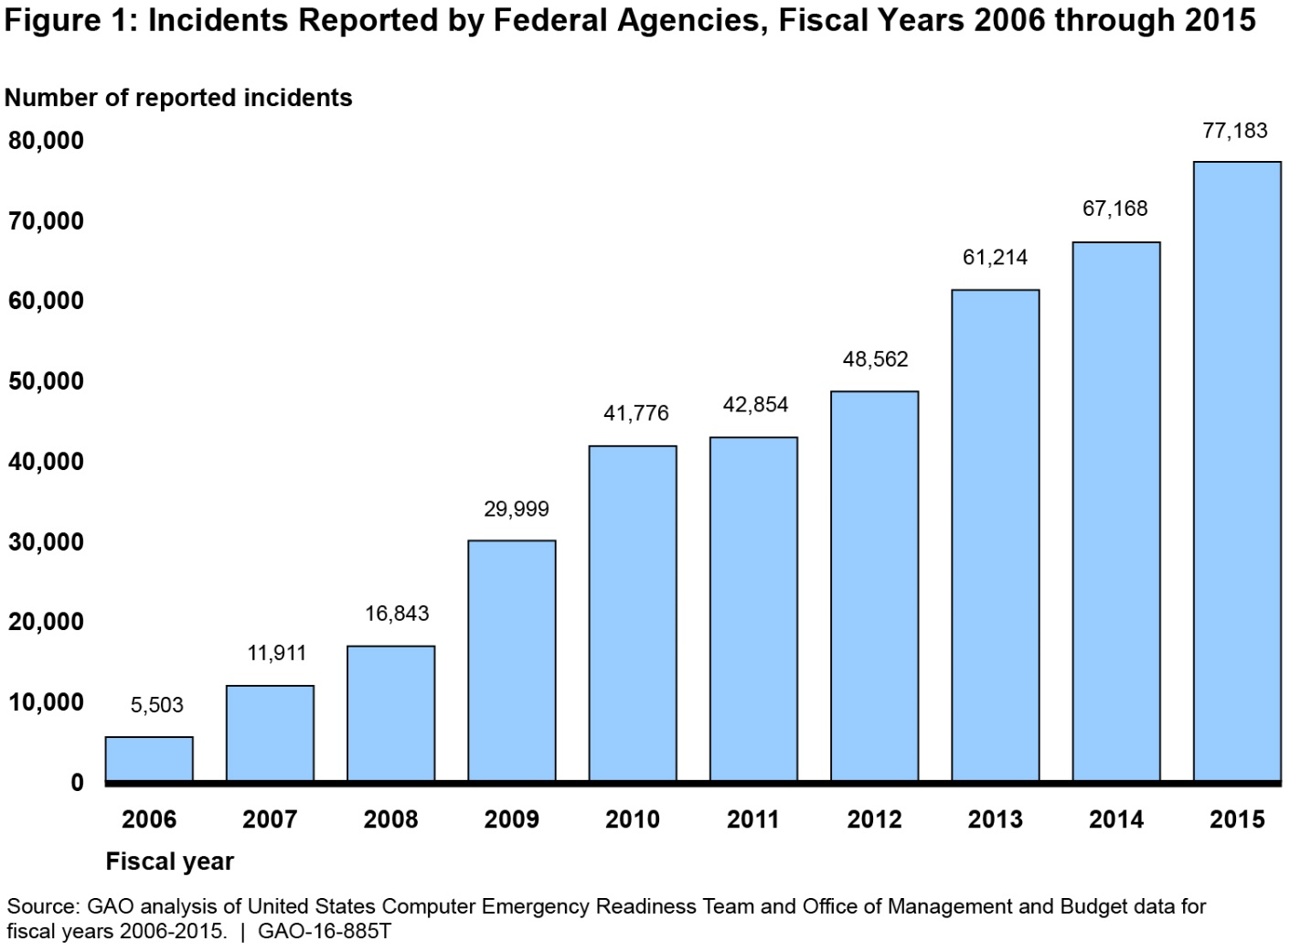
Why – Ethical Hacking
Source: CERT-India
Notes:
Other information not available

Slide 7
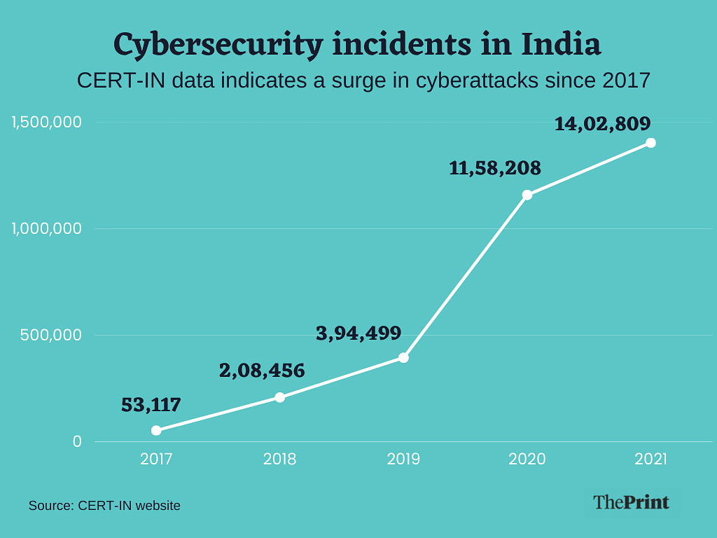
Why – Ethical Hacking
Total Number of Incidents Incidents
Source: CERT/CC

Slide 8





Why – Ethical Hacking
Protection from possible External Attacks
Social
Engineering
Automated
Attacks
Organizational
Attacks
Restricted
Data
Accidental Breaches in Security
Denial of
Service (DoS)
Viruses, Trojan Horses,
and Worms

Slide 9
Ethical Hacking - Process
Preparation
Footprinting
Enumeration & Fingerprinting
Identification of Vulnerabilities
Attack – Exploit the Vulnerabilities

Slide 10
Preparation
Identification of Targets – company websites, mail servers, extranets, etc.
Signing of Contract
  Agreement on protection against any legal issues
  Contracts to clearly specifies the limits and dangers of the test
  Specifics on Denial of Service Tests, Social Engineering, etc.
  Time window for Attacks
  Total time for the testing
  Prior Knowledge of the systems
  Key people who are made aware of the testing

Slide 11
Footprinting
Collecting as much information about the target
DNS Servers
IP Ranges
Administrative Contacts
Problems revealed by administrators
Information Sources
Search engines
Forums
Databases – whois, ripe, arin, apnic
Tools – PING, whois, Traceroute, DIG, nslookup, sam spade

Slide 12
Enumeration & Fingerprinting
Specific targets determined
Identification of Services / open ports
Operating System Enumeration
Methods
Banner grabbing
Responses to various protocol (ICMP &TCP) commands
Port / Service Scans – TCP Connect, TCP SYN, TCP FIN, etc.
Tools
Nmap, FScan, Hping, Firewalk, netcat, tcpdump, ssh, telnet, SNMP Scanner

Slide 13
Identification of Vulnerabilities
Vulnerabilities
Insecure Configuration
Weak passwords
Unpatched vulnerabilities in services, Operating systems, applications
Possible Vulnerabilities in Services, Operating Systems
Insecure programming
Weak Access Control

Slide 14
Identification of Vulnerabilities
Methods
Unpatched / Possible Vulnerabilities – Tools, Vulnerability information Websites
Weak Passwords – Default Passwords, Brute force, Social Engineering, Listening to Traffic
Insecure Programming – SQL Injection, Listening to Traffic
Weak Access Control – Using the Application Logic, SQL Injection

Slide 15
Identification of Vulnerabilities
Tools
Vulnerability Scanners - Nessus, ISS, SARA, SAINT
Listening to Traffic – Ethercap, tcpdump
Password Crackers – John the ripper, LC4, Pwdump
Intercepting Web Traffic – Achilles, Whisker, Legion
Websites
Common Vulnerabilities & Exposures – http://cve.mitre.org
Bugtraq – www.securityfocus.com
Other Vendor Websites

Slide 16
Attack – Exploit the vulnerabilities
Obtain as much information (trophies) from the Target Asset
Gaining Normal Access
Escalation of privileges
Obtaining access to other connected systems
Last Ditch Effort – Denial of Service

Slide 17
Attack – Exploit the vulnerabilities
Network Infrastructure Attacks
Connecting to the network through modem
Weaknesses in TCP / IP, NetBIOS
Flooding the network to cause DOS
Operating System Attacks
Attacking Authentication Systems
Exploiting Protocol Implementations
Exploiting Insecure configuration
Breaking File-System Security

Slide 18
Attack – Exploit the vulnerabilities
Application Specific Attacks
Exploiting implementations of HTTP, SMTP protocols
Gaining access to application Databases
SQL Injection
Spamming

Slide 19
Attack – Exploit the vulnerabilities
Exploits
Free exploits from Hacker Websites
Customised free exploits
Internally Developed
Tools – Nessus, Metasploit Framework,

Slide 20
Reporting
Methodology
Exploited Conditions & Vulnerabilities that could not be exploited
Proof for Exploits - Trophies
Practical Security solutions

Slide 21
Ethical Hacking - Commandments
Working Ethically
  Trustworthiness
  Misuse for personal gain
Respecting Privacy
Not Crashing the Systems

Slide 22
keystroke logging
creating records of everything you type on a computer or mobile keyboard
monitor your computer activity while you use your devices as normal.
Keyloggers are used for legitimate purposes like feedback for software development but can be misused by criminals to steal your data.

Slide 23
How Keystroke Logging Works
Length of the keypress
Time of keypress
Velocity of keypress
Name of the key used

Slide 24
Types of keystroke logging
Software keyloggers
-API-based keyloggers
-Form grabbing-based keylogger
-Kernel-based keyloggers
Hardware keyloggers
-Keyboard hardware keyloggers
-Hidden camera keyloggers
-USB disk-loaded keyloggers

Slide 25
WHAT IS “DOS ATTACK”
Denial-Of-Service Attack= DOS Attack is a malicious attempt by a single person or a group of people to cause the victim, site or node to deny service to it customers.
DoS = when a single host attacks
DDoS = when multiple hosts attack simultaneously

Slide 26
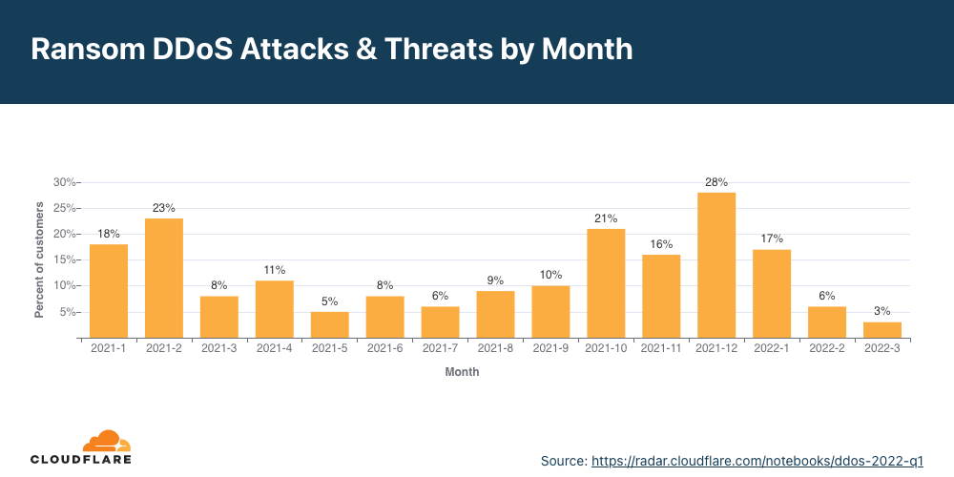
ATTACK SIZE IN GBITS-PER-SECOND

Slide 27
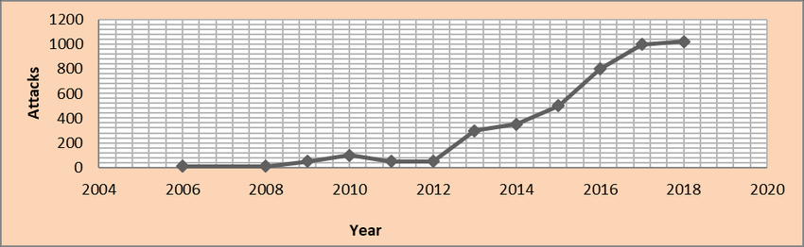
ATTACK SIZE IN GBITS-PER-SECOND

Slide 28
IDEA OF “DOS ATTACKS”
Purpose is to shut down a site, not penetrate it.
Purpose may be vandalism, extortion or social action (including terrorism) (Sports betting sites often extorted)
Flood a network with traffic, thereby preventing legitimate network traffic.
Disrupt connections between two machines, thereby preventing access to a service.
Modification of internal data, change of programs (Includes defacement of web sites)

Slide 29
HISTORY
Morris Worm (November 2, 1988)
First DDoS attack to cripple large amounts of network infrastructure
Self-replicating, self-propagating.
Exploited software commonality (monoculture)
    Fingerd buffer overﬂow exploit
    Sendmail root vulnerability
    Weak passwords

Slide 30
HISTORY
Morris Worm effect
Infected systems became “catatonic”
Took roughly three days to come under control
Ultimately infected 10% of Internet computers (6,000) and cost $ million to clean up.
Morris convicted under computer fraud and abuse act, three years probation, ﬁne of $10,000

Slide 31
HISTORY
SQL Slammer (January, 25 2003)
Exploited common software (Microsoft SQL Server) as well as hardware (Intel x86), spread rapidly in a distinct monoculture.
Non-destructive. Modified no data on infected system
Extremely simple in construction (376 bytes)
Devastating:
  120,000 computers infected at peak (1/26/2003)
  Exhausted network bandwidth
  Crashed network infrastructure (multicast state creation)
  Shut down communication (ﬁre-ﬁghting) capability

Slide 32
HISTORY
SQL Slammer effect
Extremely Virulent
Caused economic damage outside of IT infrastructure (multiple ATM outages)
Original perpetrators have never been identiﬁed or brought to justice

Slide 33
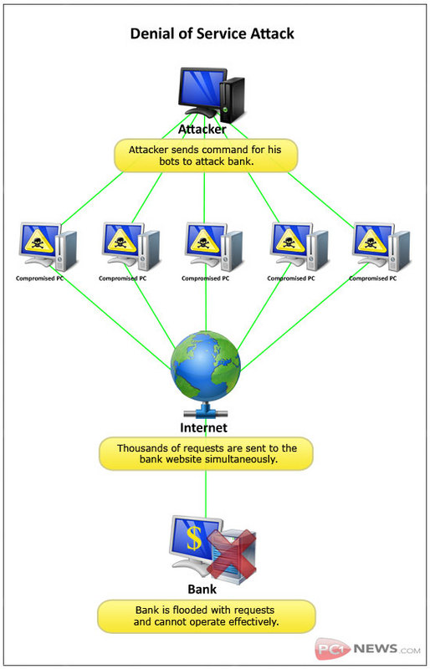
TYPES OF DOS ATTACKS

Slide 34
TYPES OF DOS ATTACKS
Penetration
Eavesdropping
Man-In-The-Middle
Flooding –syn

Slide 35
TYPES OF DOS ATTACKS
Penetration
Attacker gets inside your machine
Can take over machine and do whatever he wants
Achieves entry via software flaw(s), stolen passwords or insider access

Slide 36
TYPES OF DOS ATTACKS
Eavesdropping
Attacker gains access to same network
Listens to traffic going in and out of your machine

Slide 37
TYPES OF DOS ATTACKS
Man-in-the-Middle
Attacker listens to output and controls output
Can substitute messages in both directions

Slide 38
TYPES OF DOS ATTACKS
Flooding
Attacker sends an overwhelming number of messages at your machine; great congestion
The congestion may occur in the path before your machine
Messages from legitimate users are crowded out
Usually called a Denial of Service (DoS) attack, because that’s the effect.
Usually involves a large number of machines, hence Distributed Denial of Service (DDoS) attack

Slide 39
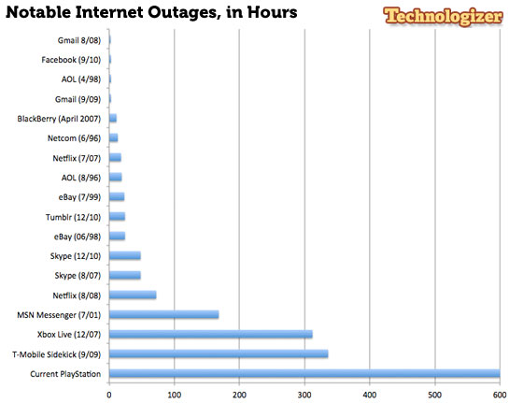
MAIN TARGETS PG 122 TOOL

Slide 40
ESTONIAN CYBERWAR APRIL 27, 2007
Weeks of cyber attacks followed, targeting government and banks, ministries, newspapers and broadcasters Web sites of Estonia.
Some attacks took the form of distributed denial of service (DDoS) attacks (using ping floods to expensive rentals of botnets).
128 unique DDOS attacks (115 ICMP floods, 4 TCP SYN floods and 9 generic traffic floods).
Used hundreds or thousands of "zombie" computers and pelted Estonian Web sites with thousands of requests a second, boosting traffic far beyond normal levels.

Slide 41
ESTONIAN CYBERWAR APRIL 27, 2007
Inoperability of the following state and commercial sites:
  The Estonian presidency and its parliament.
  Almost all of the country’s government ministries.
  Political parties.
  Three news organizations.
  Two biggest banks and communication’s firms.
  Governmental ISP.
  Telecom companies.

Slide 42
ESTONIAN CYBERWAR APRIL 27, 2007
The attack heavily affected infrastructures of all network:
  Routers damaged.
  Routing tables changed.
  DNS servers overloaded.
  Email servers mainframes failure, and etc.

Slide 43
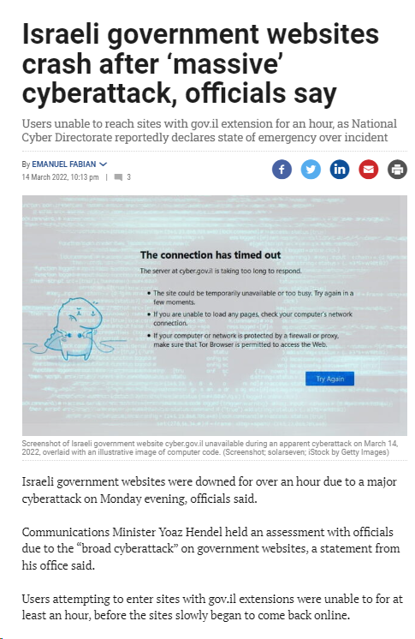

Slide 44
HOW TO DEFEND
Firewalls - can effectively prevent users from launching simple flooding type attacks from machines behind the firewall.
Switches - Some switches provide automatic and/or system-wide rate limiting, traffic shaping, delayed binding to detect and remediate denial of service attacks
Routers - If you add rules to take flow statistics out of the router during the DoS attacks, they further slow down and complicate the matter
DDS based defense
Clean pipes

Slide 45
PROSECUTION
Different governmental legislation
Too expensive
National interests
Hard to prove who used the computer

